Slide 1
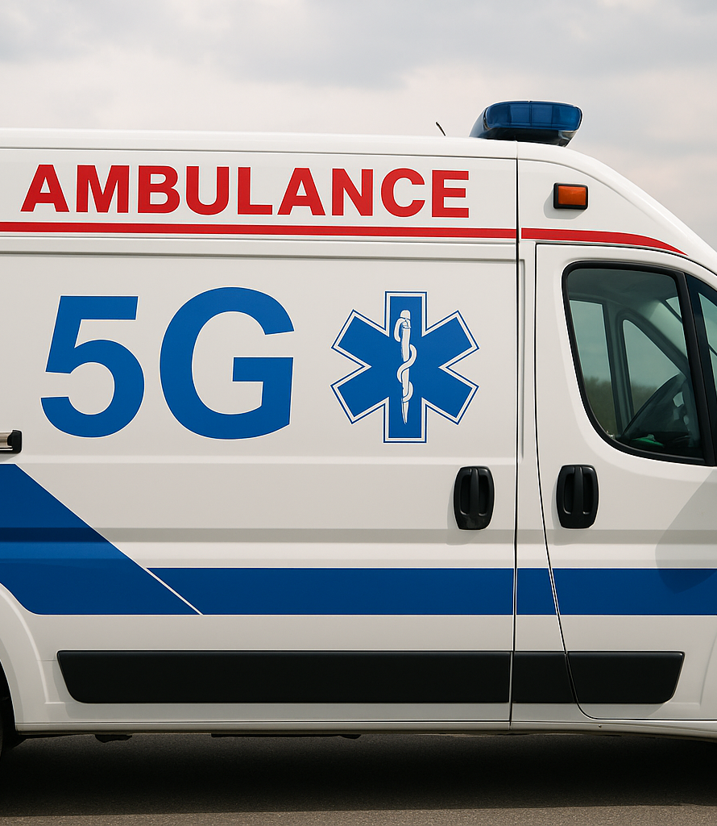
Using 5G technology to improve medical conditions in ambulances
Presented by : Mahmoud Kamal Abu Aisha
Supervised by: Dr. Yousef E. Hamouda

Slide 2
Contents
Introduction
Related Work
Test and Simulation
System Architecture
Future Scope
Conclusion
Proposed System
Results
References

Slide 3
Introduction
This paper discusses how 5G technology enhances Emergency Medical Services (EMS) by enabling ultra-low latency and high-bandwidth communication, which traditional 3G/4G networks cannot provide during emergencies. It highlights the ability of 5G to support real-time remote diagnosis through live high-definition video streaming from ambulances to hospitals. The research integrates the Negamax algorithm to optimize ambulance dispatch and resource allocation in dynamic emergency conditions. It also explores how the combined use of 5G and AI-driven systems improves patient triage, hospital preparedness, and overall response efficiency.

Slide 4
Related Work
Usman et al. (2019): Proposed a 5G-enabled mobile healthcare framework for ambulances, enabling live transmission of ultrasound videos, vital signs, and in-vehicle camera feeds for real-time physician supervision.
Zhai et al. (2021): Developed a smart ambulance service based on a 5G network and validated its effectiveness through simulations, demonstrating improved high-definition video streaming, remote diagnosis, and enhanced Quality of Service (QoS).
Yu et al. (2020): Introduced a full-stack 5G mobile-health architecture that utilizes network slicing to efficiently manage the transmission of vital signs and ultrasound images within ambulances.
Kim et al. (2020): Highlighted the critical role of 5G in empowering paramedics during prehospital care by providing ultra-reliable low-latency communication and secure data exchange, while noting infrastructure limitations in rural regions.
Ansari et al. (2021): Proposed a mobile emergency care model leveraging 5G, and demonstrated through simulation that strong signal quality and low latency can be achieved even in complex urban environments.
Dananjayan and Raj (2020): Discussed how 5G can transform healthcare broadly—enabling remote monitoring, teleconsultation, smart ambulances, and AI-assisted diagnostics.
Bhatia et al. (2024): Focused on ambulance dispatch optimization using real-time data and game theory, showing how such systems can effectively complement 5G-powered EMS solutions in urban settings.

Slide 5
Problem Statement
Emergency medical services (EMS) face persistent challenges in delivering timely and effective care, particularly during the “golden hour” where immediate interventions can save lives. Current ambulance systems suffer from delays due to inadequate communication infrastructure, especially in remote or densely populated areas. Existing 3G and 4G networks are insufficient to support real-time high-definition video, continuous patient monitoring, and remote medical consultation. The absence of robust, low-latency communication often results in delayed diagnoses, improper pre-hospital triage, and higher mortality rates .

Slide 6
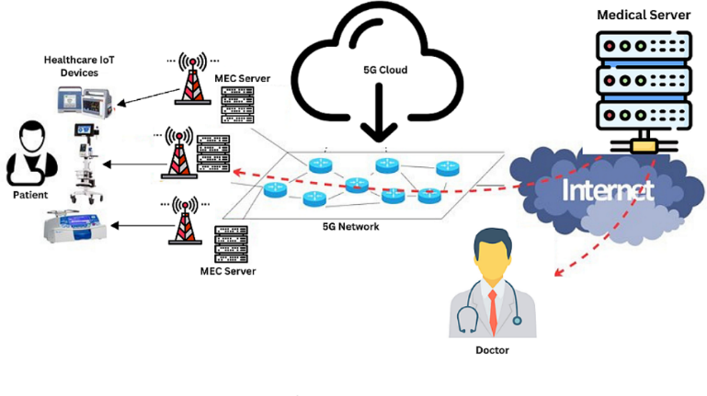
Proposed System
This study presents a 5G-enabled smart ambulance system designed to facilitate real-time medical communication between paramedics and hospital doctors. The system supports three core data streams: live HD video from the ambulance, continuous monitoring of vital signs (ECG, blood pressure, oxygen levels), and portable ultrasound imaging. It uses dedicated 5G network slices to ensure high reliability and ultra-low latency. A mobile femtocell unit within the ambulance enables stable data transmission to hospital servers and cloud-based decision systems. Physicians can monitor patient data and guide paramedics through a hospital dashboard. The architecture also supports wearable IoT devices, AI-based triage, cloud-based medical records access, and predictive analytics using GPS data to optimize ambulance routing and emergency response times.

Slide 7
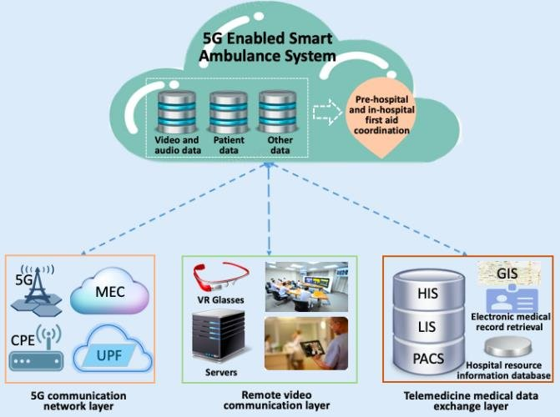
System Architecture
The 5G-enabled smart ambulance system ensures real-time, reliable communication between ambulances, paramedics, and hospitals, supporting live video, vital sign monitoring, and diagnostic imaging through dedicated 5G network slices.
5G Enabled Smart Ambulance System Overview, Three Interconnected Layers:

Slide 8
5G Communication Network Layer:
The 5G communication network layer is critical for enabling real-time, high-speed, and low-latency communication between ambulances, paramedics, and hospitals. It supports key services such as:
eMBB (enhanced Mobile Broadband) for HD video,
URLLC (Ultra-Reliable Low-Latency Communication) for time-sensitive medical data,
mMTC (massive Machine-Type Communication) for IoT device integration.
The system utilizes network slicing to create dedicated virtual networks that prioritize emergency medical data transmission, even when network traffic is high
Key Components:
Mobile 5G Unit: Installed in ambulances, it ensures stable, high-speed connectivity even in remote or urban areas with unstable coverage.
Edge Computing (MEC): Processes data closer to the ambulance to reduce latency, particularly for ECG and live video.
Low-Latency Communication: Enables instant video and data transfer to hospitals, allowing physicians to provide real-time guidance to paramedics.
Network Slicing: Allocates dedicated virtual channels for medical data, optimizing communication between ambulance and hospital systems.
Seamless Handover: Maintains continuous connectivity by ensuring smooth transitions between 5G base stations as the ambulance moves

Slide 9
The Remote Video Communication Layer
The Remote Video Communication Layer is a vital part of the 5G smart ambulance system, enabling real-time visual interaction between paramedics and hospital physicians. It utilizes 5G’s high-speed and ultra-low latency features to support high-definition, bidirectional video streaming.
Functions and Features:
High-Definition Video Streaming: Provides live, high-quality footage from the ambulance, allowing hospital staff to assess the patient’s condition and prepare for treatment in advance.
Low-Latency Communication: Ensures real-time video transfer with minimal delay, allowing doctors to issue timely, life-saving instructions to paramedics during critical emergencies.
Bidirectional Video Interaction: Supports two-way visual communication, enhancing collaboration and enabling hospital teams to guide emergency care directly and visually.
Integration with Medical Devices: Combines video with data from ECG monitors and ultrasound devices, giving physicians a complete picture of the patient’s status for accurate remote diagnosis.
Emergency Room Readiness: Real-time video allows ER teams to prepare equipment and medical staff before the patient’s arrival, reducing response time and improving critical care outcomes

Slide 10
Telemedicine Medical and Data Exchange Layer:
The Telemedicine Medical and Data Exchange Layer plays a foundational role in smart ambulance systems by enabling secure, real-time transmission of critical medical data between paramedics and hospital teams.
Features and Functions:
Real-Time Data Transmission: Continuously sends vital signs (ECG, blood pressure, oxygen levels) and diagnostic images (e.g., ultrasound) from the ambulance to the hospital with minimal delay, supporting early diagnosis and intervention.
Integration with Electronic Health Records (EHR): Patient data collected during transport is automatically synced with hospital EHR systems, reducing manual input and giving physicians instant access to medical histories.
Secure Data Exchange: Ensures all medical data is encrypted and transmitted securely over 5G, complying with privacy regulations like HIPAA and protecting patient confidentiality.
Cloud-Based Storage and Analysis: Stores patient data in the cloud for easy access and advanced analytics, enabling predictive insights (e.g., early warning for cardiac arrest or stroke).
Two-Way Remote Consultation: Allows live interaction between paramedics and physicians, enabling doctors to guide on-site treatment decisions and prepare hospital resources in advance.
Integration with Wearable Devices: Supports biosensors and IoT-enabled wearables that send real-time patient data to the ambulance and hospital, providing a continuous and comprehensive view of patient status.

Slide 11
Test and Simulation: Using Negamax Algorithm for Ambulance Dispatch Optimization
This study integrated the Negamax algorithm into the simulation phase to optimize ambulance dispatch decisions and minimize emergency response times. The goal was to allocate ambulances more effectively based on real-time data, traffic conditions, and the severity of each incident.
Simulation Setup:
A virtual environment was developed with:
Multiple ambulance stations with varied capabilities,
Diverse emergency sites with different severity levels and distances,
Dynamic traffic data to simulate congestion effects.
Algorithm Process and Cost Function:
The dispatch strategy was modeled as a game tree, where each decision node represents assigning an ambulance to an emergency. The cost function used to evaluate each assignment is:
Cost=D[i][k][t]×I[i][k]×S[k]Cost=D[i][k][t]×I[i][k]×S[k] Where:
D[i][k][t] = Travel time from ambulance station i to emergency location k at time t
I[i][k] = 1 if an ambulance is assigned from i to k, otherwise 0
S[k] = Severity level of the emergency at location k
The algorithm recursively searches for the lowest overall cost, balancing travel efficiency with emergency priority.

Slide 12
Test and Simulation: Using Negamax Algorithm for Ambulance Dispatch Optimization
Test Scenarios:
High traffic environments,
Multiple concurrent emergencies,
Dynamic changes in ambulance availability.
Results:
Achieved up to 50% reduction in response time compared to traditional dispatch strategies.
Provided efficient resource allocation by prioritizing more severe emergencies.
Demonstrated scalability in complex, multi-emergency simulations.
Conclusion:
The Negamax algorithm, supported by a real-time cost function, proved highly effective in optimizing ambulance deployment. It enhanced EMS responsiveness and decision-making, showing strong potential for integration into 5G-enabled smart healthcare systems.

Slide 13
Results of the 5G-Enabled Smart Ambulance System Implementation
Real-Time Data Transmission: The system achieved up to 90% reduction in latency compared to 4G, enabling near-instant delivery of video and vital data to hospital staff for faster diagnosis and intervention.
Network Reliability and Scalability: The 5G infrastructure handled multiple simultaneous data streams without delay or loss, maintaining performance even under heavy traffic. Network slicing ensured prioritized bandwidth for each emergency.
Improved Medical Decision-Making: Doctors received live ECG, ultrasound, and video feeds, allowing precise remote assessments and reducing the time needed for critical decisions.
AI-Based Route Optimization: Integrated GPS and AI provided real-time traffic-aware routing, minimizing travel time to hospitals even in congested areas.
Continuous Patient Monitoring & AI Triage: Wearable IoT devices continuously tracked vital signs, while AI assessed data severity in real time, allowing timely interventions for critical conditions like arrhythmia or hypoxia.
Security & Data Privacy: All transmissions were encrypted and HIPAA-compliant, ensuring the integrity and confidentiality of patient information throughout the communication process.

Slide 14

CONCLUSION
The integration of 5G technology in smart ambulances significantly enhances emergency medical services by reducing latency, enabling real-time remote diagnosis, and supporting AI-based triage and route optimization. It improves response times, patient outcomes, and coordination between paramedics and hospitals. However, widespread adoption depends on overcoming infrastructure costs and ensuring rural network coverage. The system holds strong potential to revolutionize emergency care through faster, more effective, and broader-reaching medical services.

Slide 15

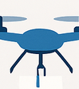
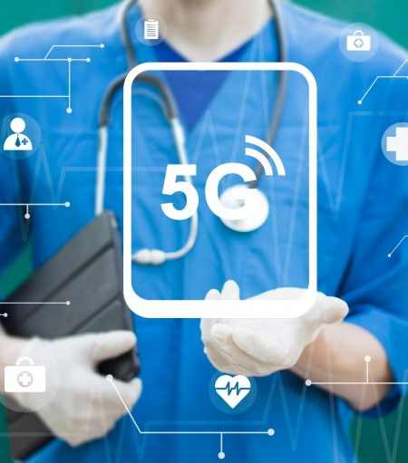

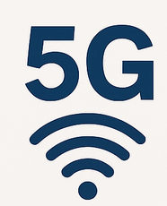
FUTURE SCOPE
Integration with Advanced Technologies (AI, AR, ML)
Adoption of Autonomous Vehicles and Drones
Expansion of 5G Coverage to Rural and Remote Areas
Smart City and Telehealth Integration
Real-Time Analytics and Connected Health Devices

Slide 16


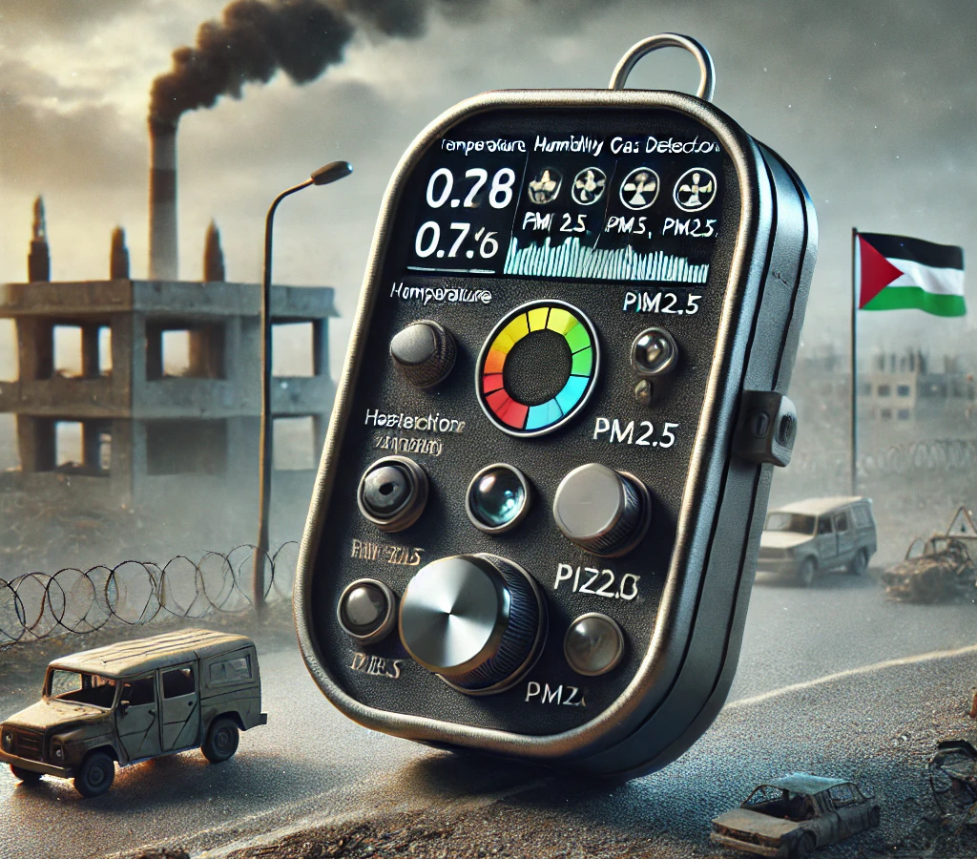
Thank you
Mahmoud Abu Aisha
mk.abuaisheh@std.alaqsa.edu.ps

